Slide 1
GPU Computing
Lab1 C Refresher and Environment Setup

Slide 2
Agenda
C refreshment resources
Selected topics in C
Pointers
Void pointers
Constant pointers
Double pointers
Arrays
Casting and type conversion
NVCC
Environment setup on different platforms
CUDA-GDB
Requirement

Slide 3
C Refresher
As we are going to heavily use C programming throughout the course labs, it’s recommended we get a quick refresher on C basics (data types, variables, arrays, conditional statements, loops, functions, static keyword, … etc)
Recommended Resources:
https://www.learn-c.org/
https://www.tutorialspoint.com/cprogramming/c_quick_guide.htm
https://www.geeksforgeeks.org/c-cheatsheet/

Slide 4
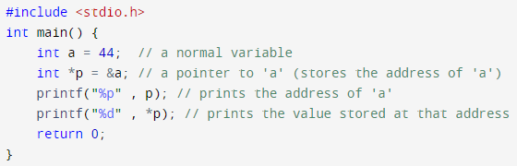
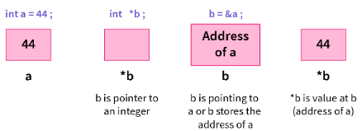
Selected Topics: Pointers
A pointer in C is a variable like any other one, but holds the address of some other variable. We use them when we want to allocate some memory on the heap which is also known as dynamic memory allocation.

Slide 5

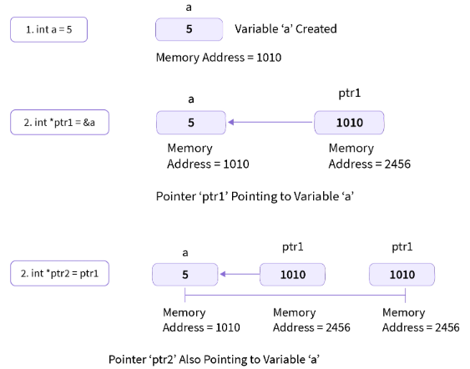
Pointers (cont.)
General pointer declaration syntax: datatype *pointer_variableName;
you must make sure that the data type you're using is a valid C data type and that the pointer and the variable to which the pointer variable points have the same data type
Pointer Initialization can be done through either of 2 methods:

Slide 6
Different types of pointers
Null Pointer: A type of pointers created by assigning a null value to the pointer. It can be of any data type. It has a value of 0 in it. The operating system reserves memory at address 0; most of them do not allow programs to access memory at that address (null pointer exception).
Void Pointer: A generic pointer that isn't associated with any data type. It can be typecasted to any type.
Wild Pointer: A pointer that isn't initialized to anything. Dereferencing such a pointer has undefined behavior that may crash the program or give a garbage value.

Slide 7
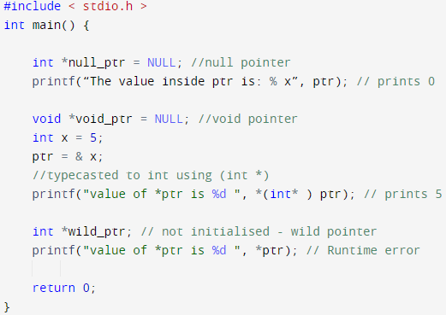
Different types of pointers (cont.)

Slide 8
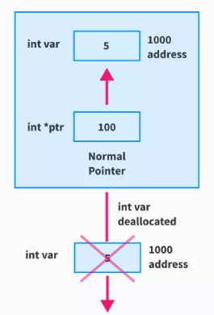
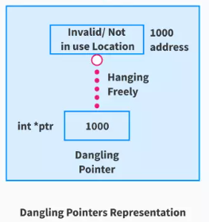
Different types of pointers (cont.)
Dangling Pointer: A pointer that points to a deallocated memory block, results in the dangling pointer problem, caused by 3 typical cases:
Deallocation of memory
Function Call
Variable goes out of scope

Slide 9
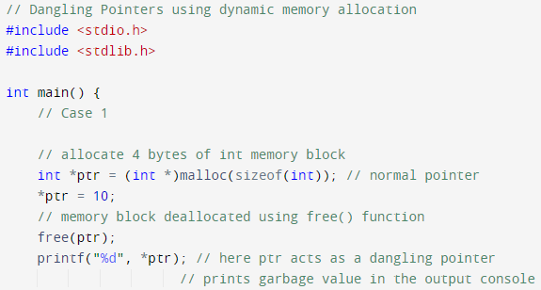
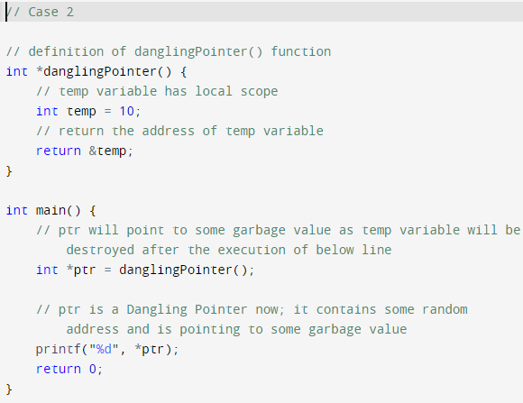
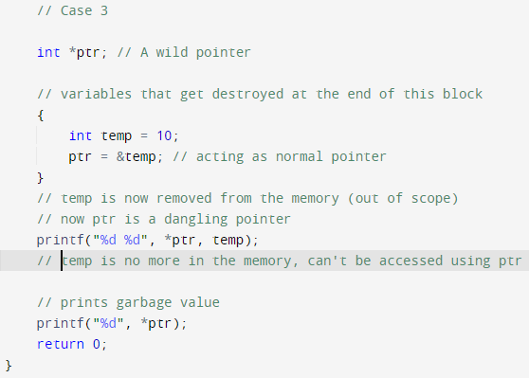
Dangling pointer (cont.)

Slide 10
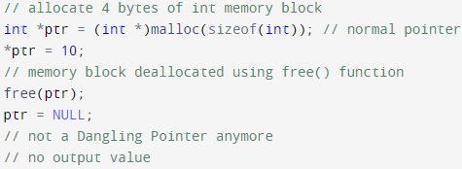
Dangling pointer (cont.)
We can fix the dangling pointer problem by:
assigning NULL to the ptr pointer as soon as the memory block pointed by the ptr has been deallocated using the free().

Slide 11
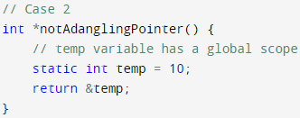
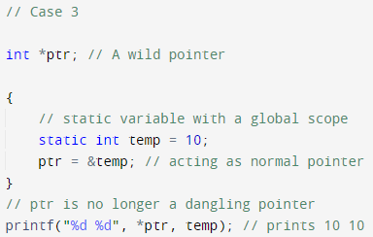
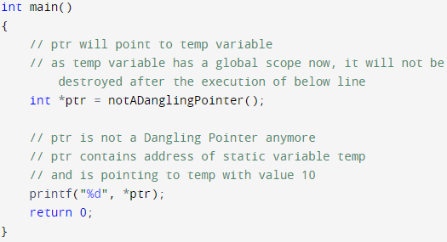
Dangling pointer (cont.)
2. Using Static variables are the variables that remain in the memory until the execution of the program finishes.

Slide 12
Constant Pointers
Similar to constant variables, we can use constant pointers in multiple ways:
Constant pointer (once given an address to point to, it cannot be changed later) <data type> * const <pointer name> = <memory address>
Pointer to Constant; points to a constant variable (created using const) const <data type> * <pointer name> = &<constant variable name>; OR <data type> const * <pointer name> = &<constant variable name>;
Constant pointer to constant; the previous two cases combined const <data type> * const <pointer name> = &<constant variable name>; OR <data type> const * const <pointer name> = &<constant variable name>;

Slide 13
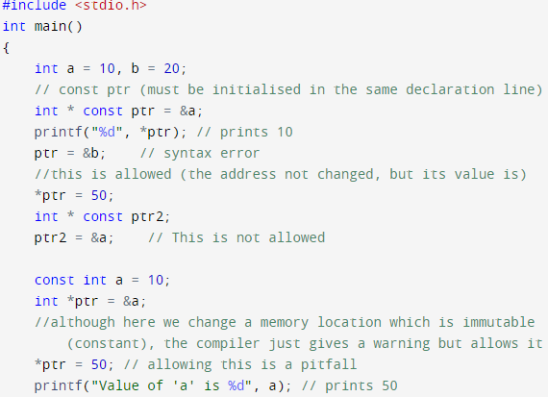
Constant Pointers (cont.)

Slide 14
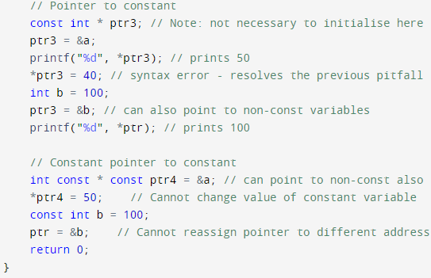
Const Pointers (cont.)

Slide 15
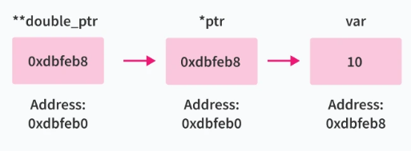
Double Pointers
A pointer to pointer is another form of a pointer that points to the address of a pointer which points to the address of a variable.
Declaration Syntax: pointer_data_type **variable_name;

Slide 16
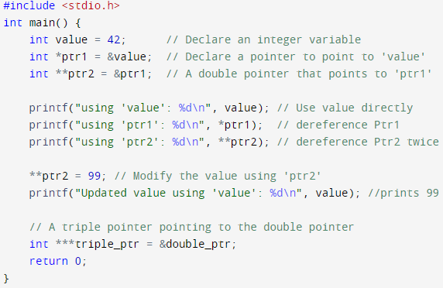
Double Pointers (cont.)

Slide 17
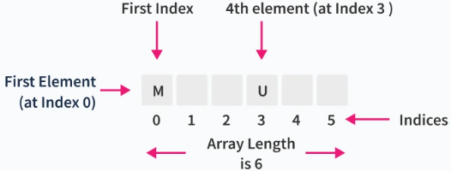
Arrays (1D, 2D, … ND)
1D array in C can be visualized as a single row to store the elements. All the elements are stored at contiguous memory locations.
Allocate a 1D array statically: int arr[5];
Allocate an array of 50 ints dynamically int *p_array = malloc(sizeof(int) * 50);
Compile time Initialization: int nums[5] = {0, 1, 2, 3, 4};
Shallow copying: int array1[5] = {0, 1, 2, 3, 4}; int array2[5]; array2 = array1; // copy the address not the array elements
Deep Copying: allocate a new array and do element-wise copying.

Slide 18
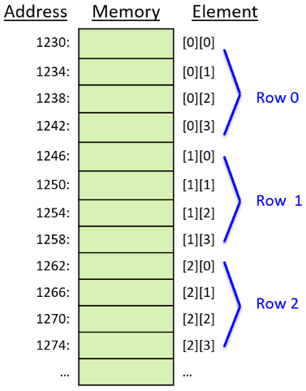
2D Arrays
Can be viewed as a table or a matrix of 2 dimensions
Static allocation: int A[10][20];
Dynamic allocation int r = 3, c = 4, i, j, count; int* arr[r]; for (i = 0; i < r; i++) arr[i] = (int*)malloc(c * sizeof(int));
Compile time initialisation: Method 1: int A[2][3] = {3, 2, 1, 8, 9, 10} Method 2: int A[2][3] = {{3, 2, 1}, {8, 9, 10}};
Representation in memory

Slide 19
Type Conversion
Type conversion in C is the process of converting one data type to another. The type conversion is only performed to those data types where conversion is possible.
Basic syntax: int x; float y; y = (float) x;
There are 2 types of conversion: implicit (type coercion) - explicit (type casting)

Slide 20
Type Conversion (cont.)
Implicit: occurs automatically by the compiler when a value of one data type is assigned to a variable of another data type. This typically happens when a "smaller" data type is assigned to a "larger" data type, preserving data integrity.
Explicit: when the programmer intentionally changes the data type of a value. This is done using built-in functions or operators that the programming language provides int num = 10; double result = num; // Implicitly converts 'num' to a double double result = (double) num; // Casting 'num' to a double char character = (char) num; // Explicitly casting 'num' to a char double pi = 3.14159265359; int roundedPi = (int) pi; // Explicitly casting 'pi' to an integer- roundedPi = 3

Slide 21
Type Casting
Recall: C provides several built-in type casting functions to perform type casting in C. Here are five commonly used ones:
atof(): Converts a string to a double.
atoi(): Converts a string to an integer.
itoa(): Converts an integer to a string.
itoba(): Converts an integer to a binary string.
atoi(): Converts a binary string to an integer. These functions are particularly useful when dealing with string-to-number or number-to-string conversions.

Slide 22
NVCC
NVIDIA CUDA Compiler Driver: is a crucial component in the CUDA ecosystem. The general compilation process for CUDA applications involves intricate steps including splitting, compilation, preprocessing, and merging for each source file.
NVCC’s primary purpose is to abstract away the complexities of CUDA compilation from developers. It accepts conventional compiler options (such as macros, include/library paths, and steering compilation) and translates them to appropriate host compiler commands.
During non-CUDA phases, NVCC forwards compilation tasks to a general-purpose C++ host compiler. For CUDA phases, NVCC handles preprocessing stages, host code compilation, and linking with CUDA runtime libraries.
Nvcc accepts wide range of file types, including .c, .cpp, .cc, .cu, .gpu, .a, .lib, .so, and others.

Slide 23
Installation
For GPU-enabled computers, follow the Nvidia guide on how to install Cuda toolkit and setup your environment here: https://docs.nvidia.com/cuda/cuda-installation-guide-linux/index.html
Otherwise, Google Colab also provide some accessibility to GPUs. Follow this link: https://www.geeksforgeeks.org/how-to-run-cuda-c-c-on-jupyter-notebook-in-google-colaboratory/
Hint: you may need to use ‘%load_ext nvcc4jupyter’ instead of ‘%load_ext nvcc_plugin’
Hint: you may need to use ‘%%cuda’ instead of ‘%%cu’

Slide 24
CUDA-GDB
A Command-line debugger equipped with Cuda toolkit, it includes:
All the standard GDB debugging features
Seamless CPU and GPU debugging within a single session
Breakpoints and Conditional Breakpoints
Inspecting memory, registers, local/shared/global variables
Supporting multiple GPUs, multiple contexts, multiple kernels
Runtime Error Detection (stack overflow,...)

Slide 25
CUDA-GDB (cont.)
Compile your file with debugging symbols flags: -g (host code) -G (device code) $nvcc -g -G -gencode arch=compute_20,code=sm_20 mycode.cu -o myapplication Note: -gencode flag is to assign some specific architectures
Invoke CUDA-GDB from the command line $cuda-gdb my_application (cuda-gdb) _
Launch the application (cuda-gdb) run
Resume the application (all threads) (cuda-gdb) continue
Kill the application (cuda-gdb) kill
Single stepping Over function calls: next Into function calls: step

Slide 26
CUDA-GDB (cont.)
Add breakpoints at specific lines to help tracing the bug
Add breakpoint at the start of a function: (cuda-gdb) break my_kernel
By file name and line number: (cuda-gdb) break mycode.cu:380
By address: (cuda-gdb) break *0x3e840a8
Conditional breakpoint: (cuda-gdb) break my_kernel if threadIdx.x == 13
Switch Focus to specific block/thread to trace its local components
Switching focus to CUDA kernel 2 block (2,0,0), thread (4,0,0)
(cuda-gdb) cuda kernel 2 block 2 thread 4
Switching focus to CUDA kernel 2 block (2,0,0), thread (5,0,0)
(cuda-gdb) cuda thread 5
Get the current focus: (cuda-gdb) cuda kernel block thread kernel 2 block (2,0,0), thread (5,0,0)

Slide 27
CUDA-GDB (cont.)
Thread Focus operations
Obtain list of running kernels: (cuda-gdb) info cuda kernels
Obtain list of running threads for kernel 2: (cuda-gdb) info cuda threads kernel 2
Read a source variable (must be live): (cuda-gdb) print my_variable
Write to a source variable: (cuda-gdb) print my_variable = 5
Can read/write memory as well: (cuda-gdb) print *my_pointer
Memory checking: resembles valgrind tool Example: (cuda-gdb) set cuda memcheck on (cuda-gdb) run [Launch of CUDA Kernel 0 (applyStencil1D) on Device 0] Program received signal CUDA_EXCEPTION_1, Lane Illegal Address. applyStencil1D<<<(32768,1,1),(512,1,1)>>> at stencil1d.cu:60

Slide 28
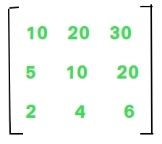
Requirement
It’s required to write a c Program that accepts a 2D array and returns the sum of the numbers formed by concatenating the elements(non negative) of each column. E.g. the given matrix returns 51362
Explanation: ‘1052 + 20104 + 30206 = 51362’
Input format: command line arguments as: nrows ncols nrows*ncols numbers For this matrix: 3 3 10 20 30 5 10 20 2 4 6
The program should print 51362, nothing more. It must be compiled through nvcc successfully. You may try to use the debugger.

Slide 29
Resources
https://www.scaler.com/topics/c/
https://developer.download.nvidia.com/GTC/PDF/1062_Satoor.pdf
https://colab.research.google.com/drive/1GJOfTp56OeQRdE4u2_S7pUNRcJb4ik9X?usp=sharing#scrollTo=5ou-b1S9TYBp

